Slide 1

Computational Methods in
Power System Analysis
Lecture-3b Incidence and network matrices
By
Dr. Wazir Muhammad Laghari
Electrical Engineering Department
BUET, Khuzdar

Slide 2
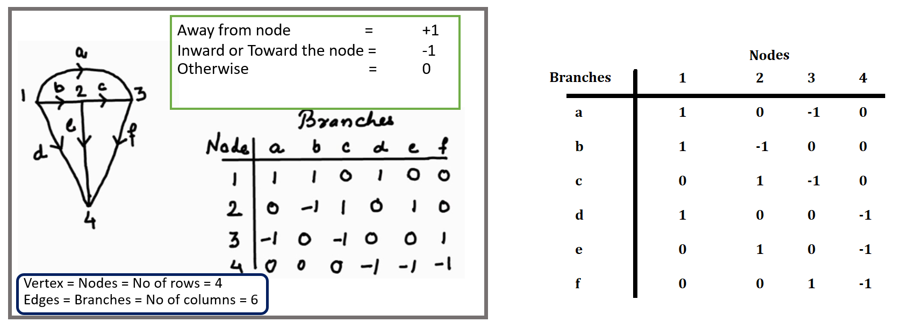
Element-node incidence matrix A^
The incidence of elements to nodes in a connected graph is shown by the element-node incidence matrix. The elements of the matrix are as follows:
1 if the element away from the node.
-1 if the element toward the node.
Otherwise 0.
Sum of any row is equal to zero.
Rank of A^ is < n, where n is number of node
A rank of a graph is n-1, where n is the number of node in the graph.
4-1<5
Incidence matrix A
Element-node incidence matrix A^

Slide 3
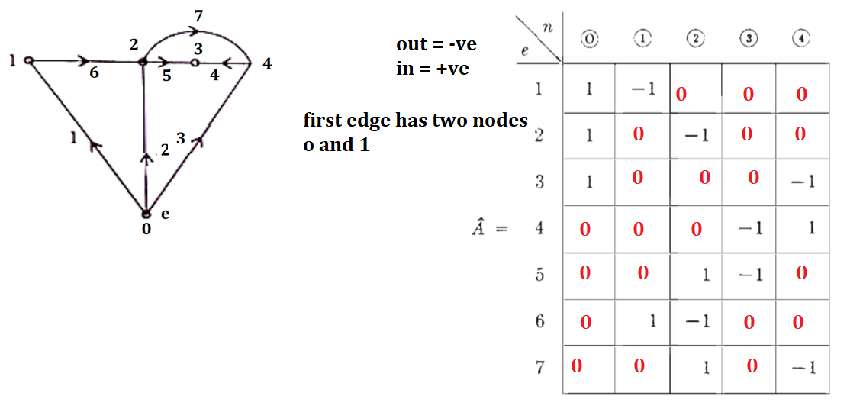
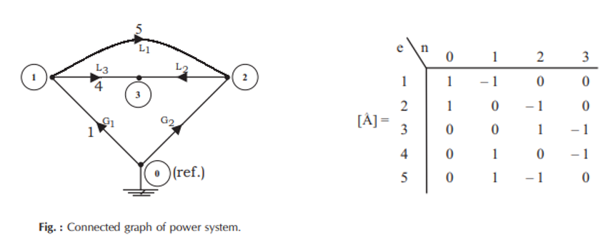
Q: Find the element-node incidence matrix of the graph as shown in Figure given below
Chapter 3 page NO 31

Slide 4
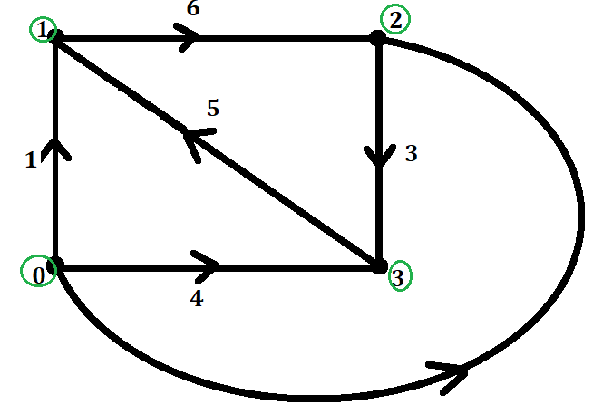
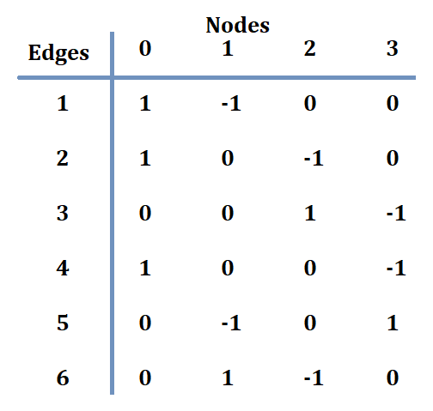
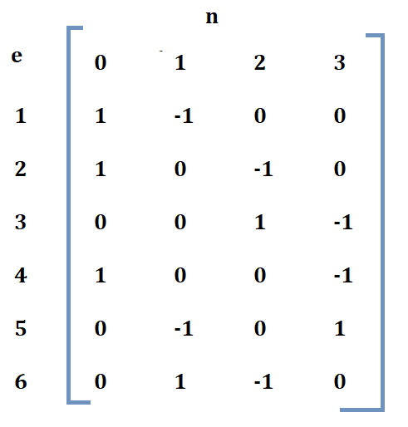
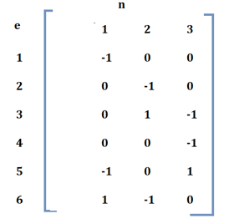
BUS INCIDENCE MATRIX A
Any node of a connected graph can be selected as the reference node. Then, the variables of other nodes, referred to as buses, can be measured with respect to the assigned reference. The matrix obtained from A^ by deleting the column corresponding to the reference node is the element-bus incidence matrix A, which will be called the bus incidence matrix. The dimension of this matrix is e x (n-1).
The dimension of this matrix is e x (n-1) = 6 x (4-1) = 6 x 3.
Node Incidence Matrix = =
Bus Incidence Matrix = A

Slide 5
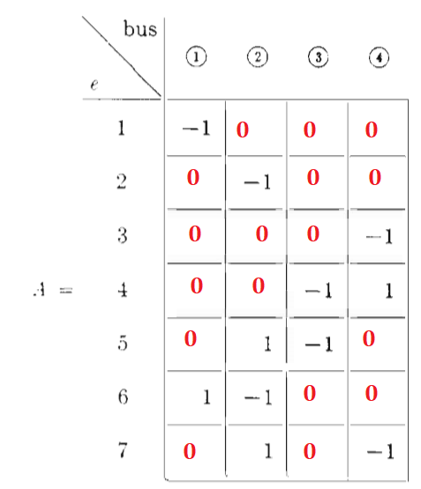
Q: Find the Bus Incidence matrix of the graph as shown in Figure given below
Page No 32

Slide 6
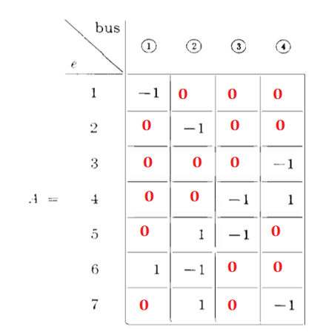
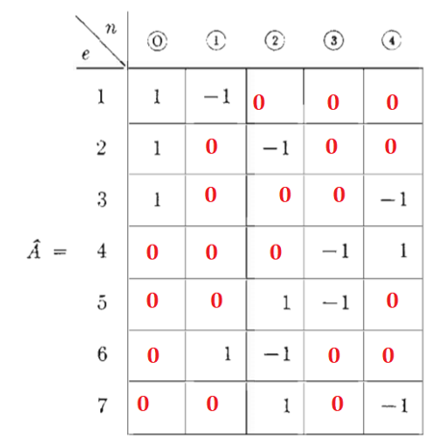
Can we form Node Incidence Matrix From Bus Incidence Matrix?
Yes, you put any value that sum of column is zero
Bus Incidence Matrix Node Incidence Matrix

Slide 7
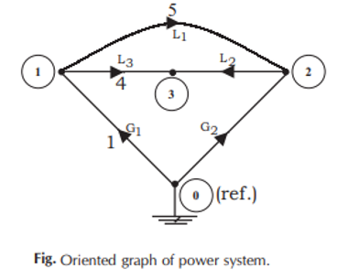
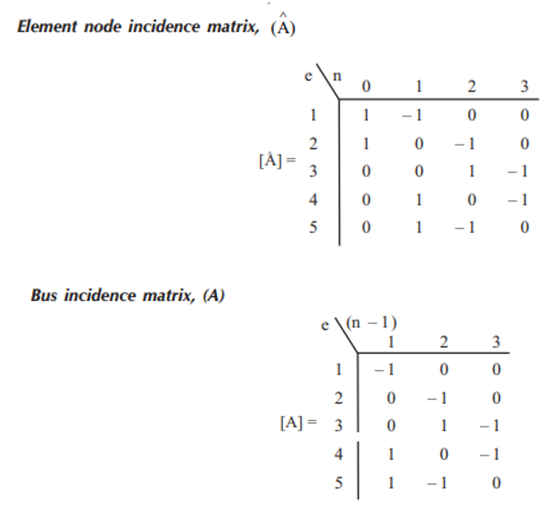
Q: Find the Bus Incidence Matrix of the graph given below

Slide 8
Branch-path incidence matrix K
The incidence of branches to paths in a tree is shown by the branch-path incidence matrix, where a path is oriented from a bus to the reference node. The elements of this matrix are:
1, if the ith branch is in the path from the jth bus(node) to reference and is oriented in the same direction.
-1, if the ith branch is in the path from the jth bus (node) to reference but is oriented in the opposite direction.
0, if the ith branch is not in the path from the jth bus to reference.

Slide 9
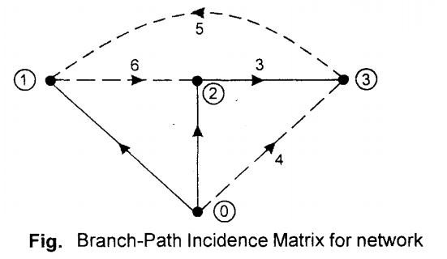
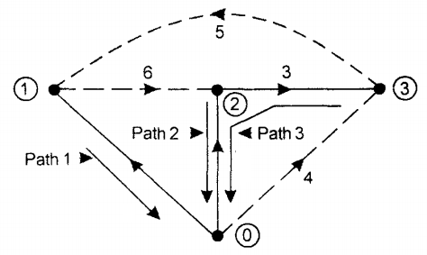
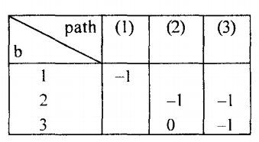
Q: Find the Branch-Path Incidence Matrix of the given directed graph as shown in Figure below:
Path 1 has 1 node
Path 2 has also 1 node
Path 3 has 2 nodes (3 and 2)
0 0
0
0

Slide 10
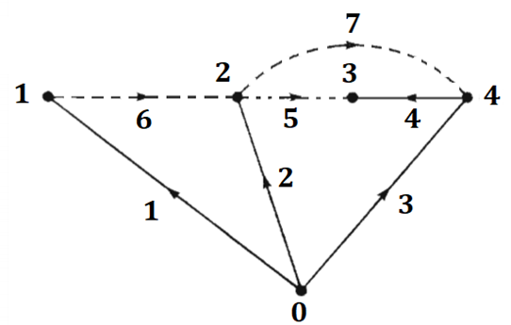
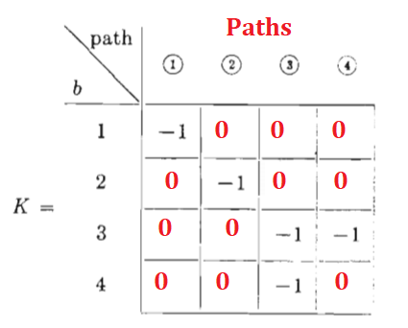
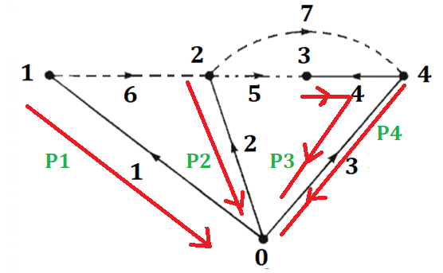
Q: Find the Branch-Path Incidence Matrix of the given directed graph as shown in Figure below:
Same problem page No 33

Slide 11
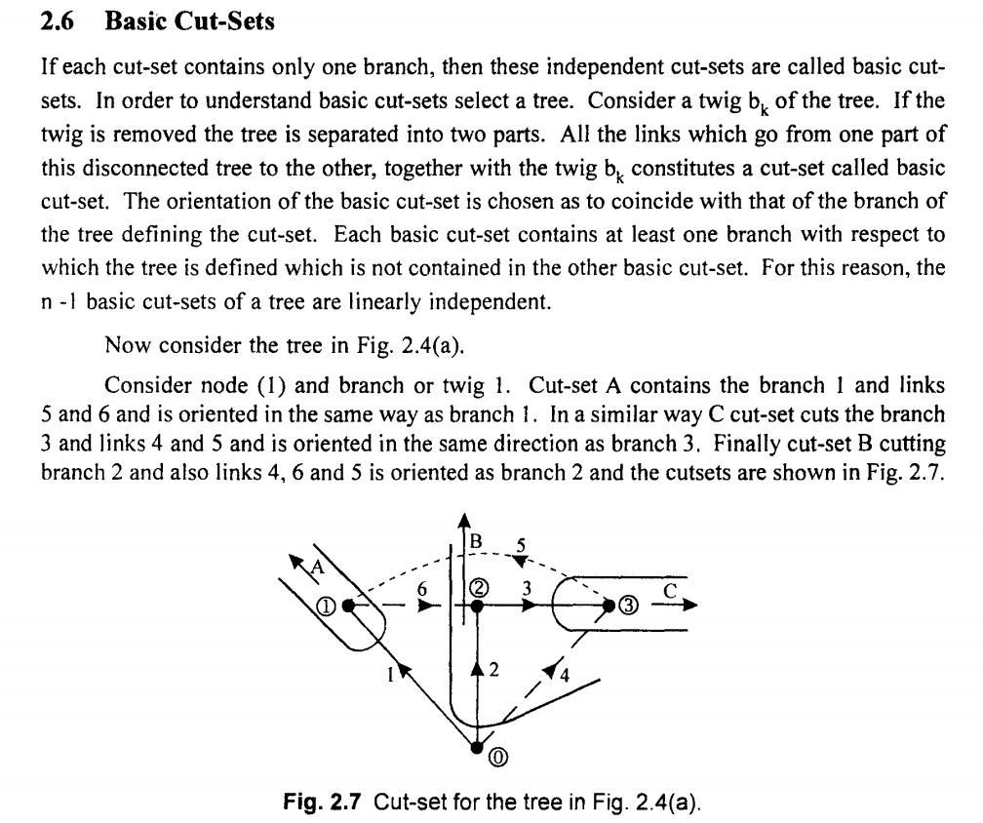
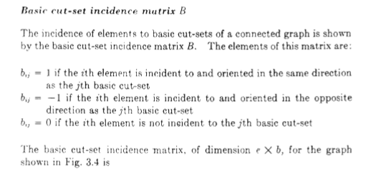
Basic Cut-Sets
If each cut-set contains only one branch, then these independent cut-sets are called basic cut-sets.
In order to understand basic cut-sets select a tree.

Slide 12
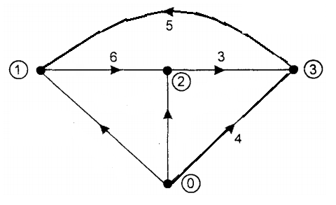
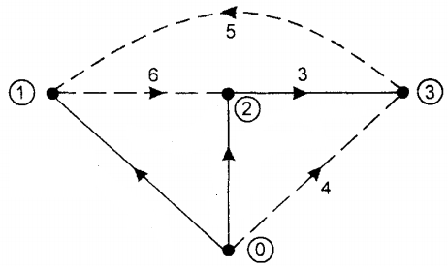
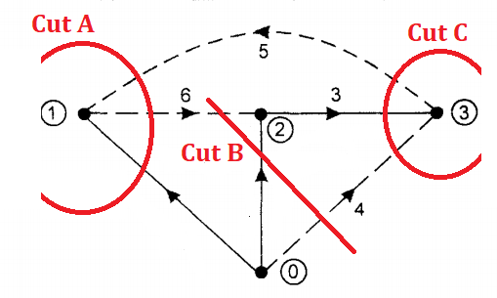
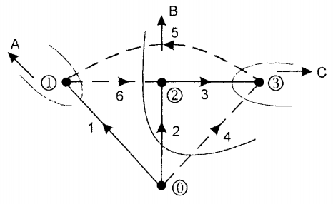

Slide 13
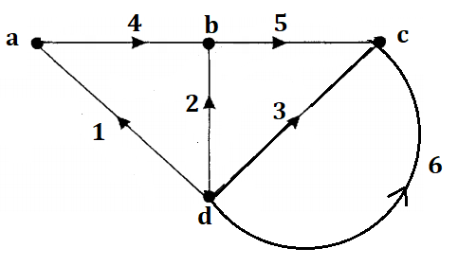
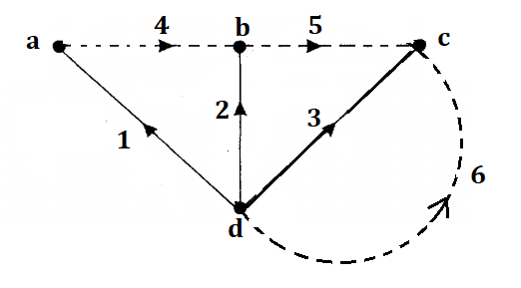
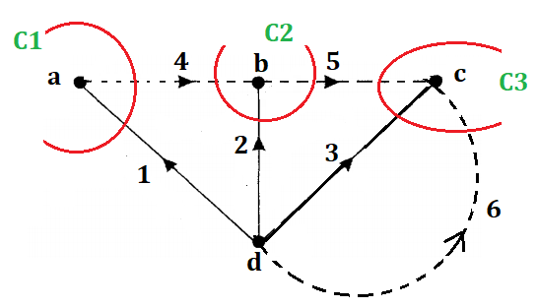

Slide 14
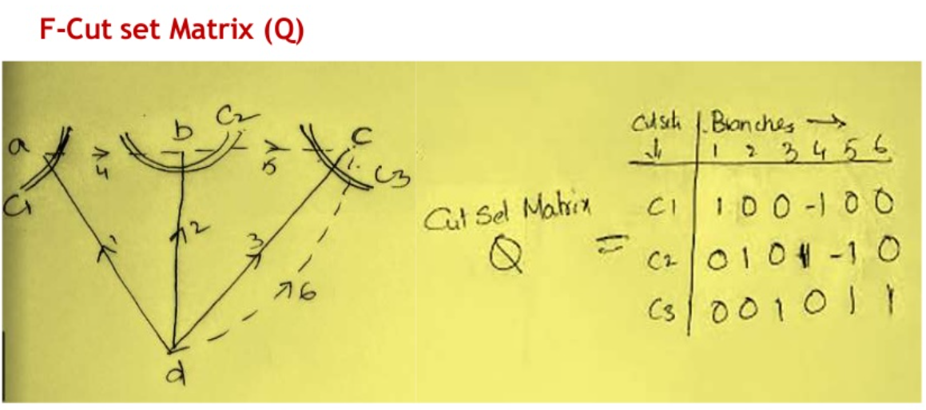

Slide 15
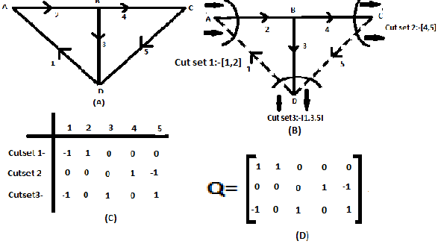

Slide 16


Slide 17
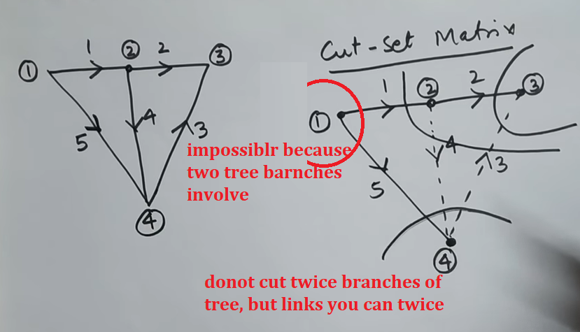

Slide 19
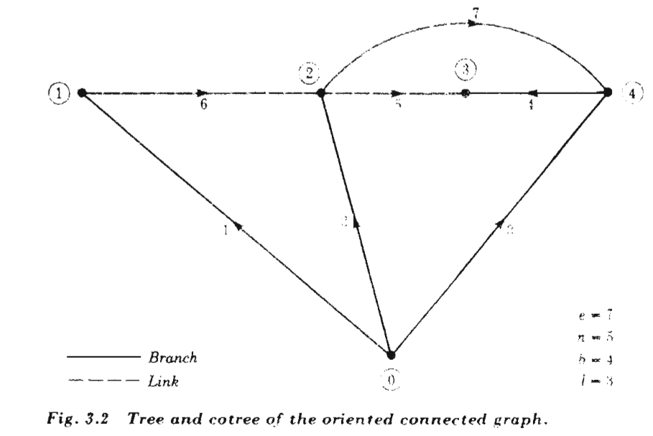
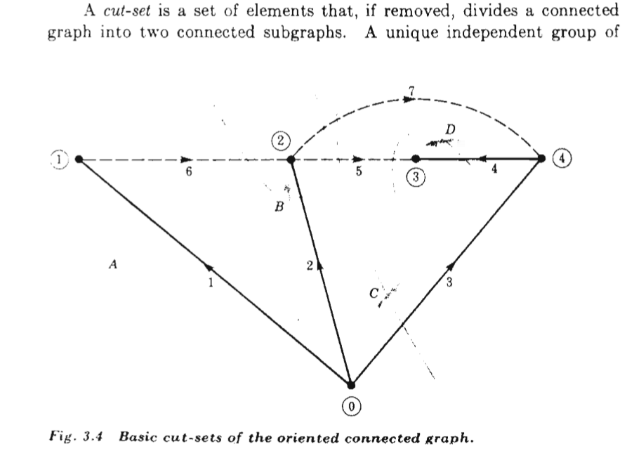
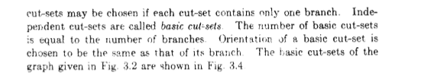

Slide 20
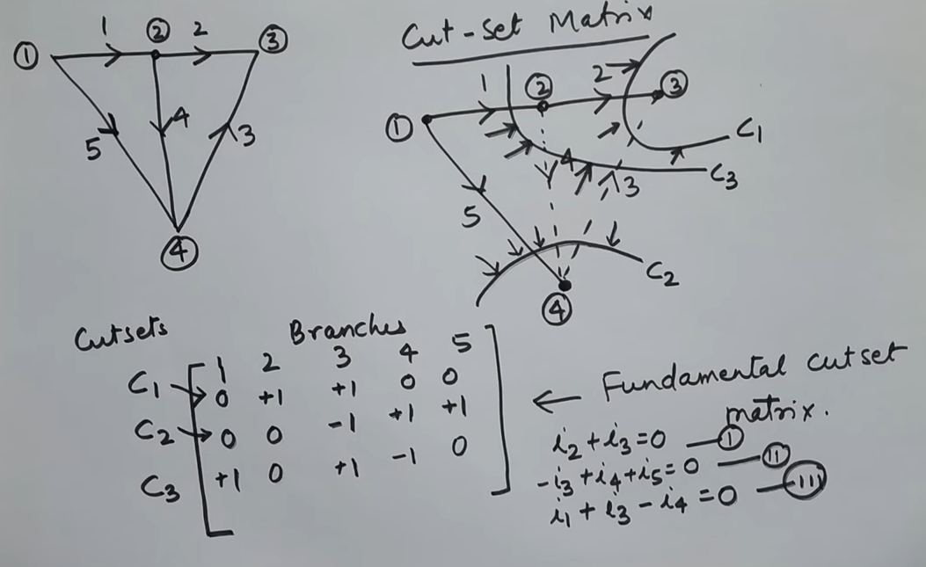
In cut set we make CKL equation and in Tie set we make KVL equation

Slide 21
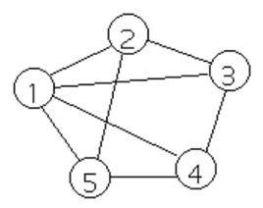
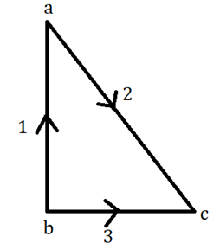
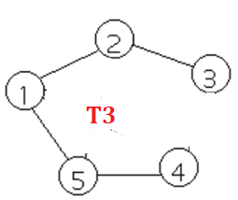
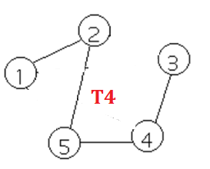
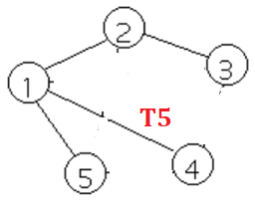
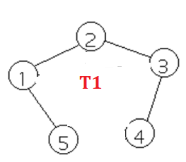
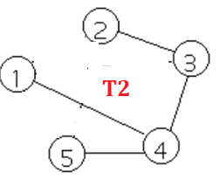
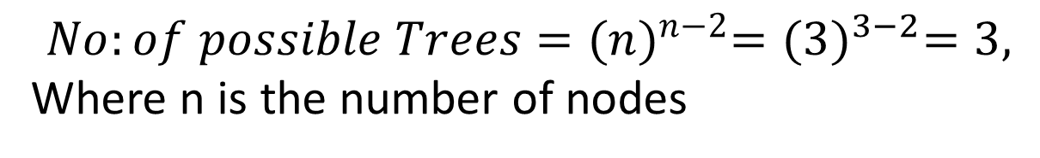
Regular Graph
It is a graph in which each node is connected to all other nodes, than it is called as Regular Graph.
$$No:of possible Trees={(n)}^{n−2}={(3)}^{3−2}=3,$$
Where n is the number of nodes
FORMULA TO CALCULATE NUMBER OF TREES IN REGULAR GRAPH
$$No:of possible Trees={(n)}^{n−2}={(5)}^{5−2}={(5)}^{3}=175$$

Slide 22
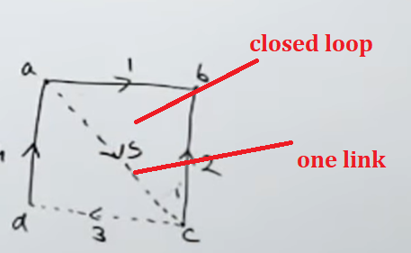
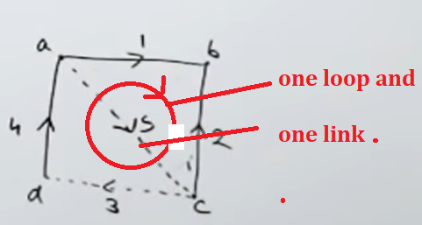
Tie Set
Rows shows a Tie set or Cut set
Tie set is a such type of closed loop, in which contain only one link

Slide 23
Tie Set Matrix (B) OR (Link Currents)
It is a subset of circuit matrix. It is represented by B. OR
It is a set of branches contained in a loop such that each loop contains one link or chord and the remainder are tree branches.
For a given graph, select any tree and remove its all links.
Then replace each link one at a time, it will form a closed path or loop or closed circuit along with some of the tree branches existing.
The circuits formed by replacing each link in tree are called fundamental circuits or f-circuits or tiesets.
Tie set we used KVL equations

Slide 24

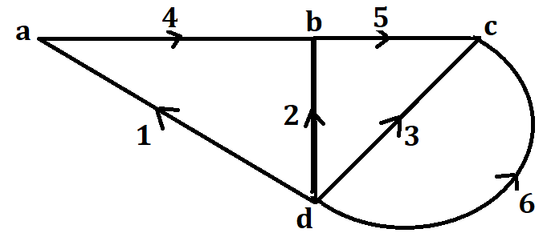
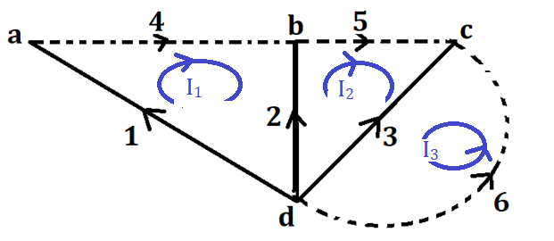
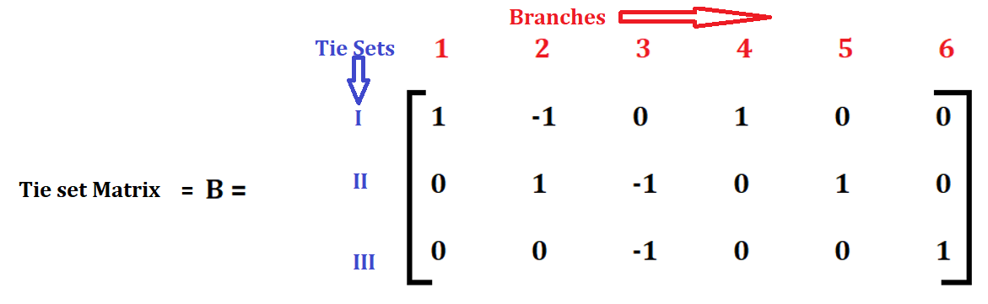

Slide 25
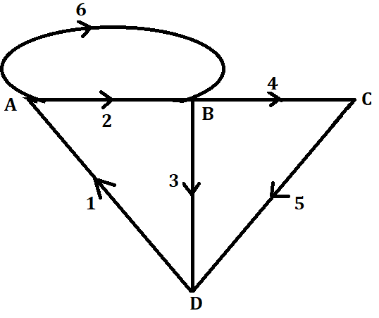
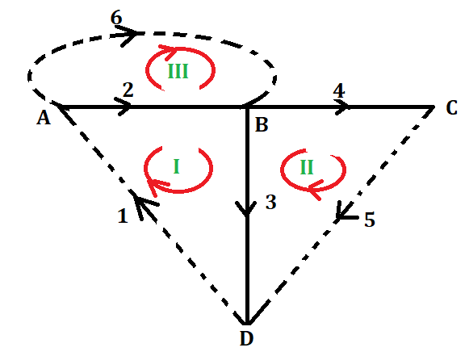
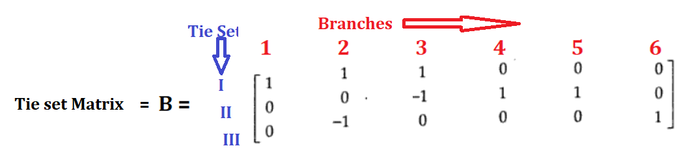

Slide 26




Slide 27
Cut-set Matrix

Slide 28




Slide 29


Slide 30


Slide 31


Slide 33



Slide 34


Slide 35


Slide 36
Any number possible trees than that combination of tieset and cutset matrix we can build
If our possible trees are 3 than possible cutset and tieset matrix are also three.
Told you that make cut set of tree of 1, 5 and 6 branches

Slide 37


Slide 38
Branches denoted as a columns same as Incidence matrix
Rows are denoted as Tieset or Cutset

Slide 39

Tieset
Tiset is a closed and cotain only one link is called Tieset

Slide 40

Tieset
Direction of loop current is the direction of link

Slide 41


Slide 42
With the help of Tieset we can calculate the Branch Current , if we consider along the column wise.
With the help of Tieset matrix we can also calculate the KVL equations along the rows

Slide 43


Slide 44


Slide 45


Slide 46


Slide 47




Slide 48


Slide 49


Slide 50


Slide 51


Slide 52


Slide 53


Slide 54


Slide 55


Slide 56


Slide 57


Slide 58


Slide 59


